Slide 1
Exam Walk-Through
Level 3 Health and Social Care: Principles and Contexts – Unit 2 4973PA
Notes:
Hello.
This is a walkthrough of the Level 3 Health and Social Care: Principles and Contexts - Unit 2 Sample Assessment Material

Slide 2
What you should have in front of you:
A copy of the exam paper
A pen and pencil
A highlighter pen
A watch
Post-It notes
Notes:
In front of you, you should have:
A copy of the exam paper
A pen and pencil
A highlighter pen, which will help you identify key points in the question
A watch to help you keep an eye on the time
And Post-It notes – in case you need to write down any queries to ask your teacher

Slide 3
What this exam paper is all about:
This paper is 1 hour, 45 minutes long.
It is testing your knowledge of health and social care principles and contexts.
The paper is made up of seven questions.
The question types vary.
The paper will assess AO1, AO2 and AO3.
The total mark for this paper is 100.
All question papers for Health and Social Care: Principles and Contexts have the same layout as this one.
Notes:
This exam paper is from the SAMs.
It is testing the content you will have been taught for Level 3 Health and Social Care: Principles and Contexts.
The exam is 1 hour and 45 minutes long.
The paper is made up of 7 questions.
The question types vary.
The paper will assess AO1, AO2 and AO3.
The total mark for this paper is 100.

Slide 4
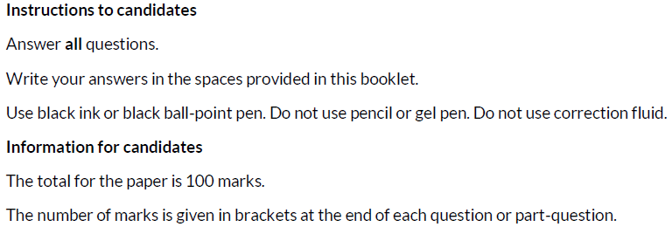
What should I do first?
1. Read the front cover of the exam paper.
2. Make sure your name and candidate number are on your answer booklet.
Notes:
First of all, read the instructions on the front cover of the exam paper.
Read the Instructions To Candidates section and the Information To Candidates section.
Write your name and candidate number in the correct section of the booklet.

Slide 5
General points on exam technique
Read through the whole question before starting to answer. This will help you understand what is required of you.
Use a highlighter to pick out key words.
Look at the command words and the number of marks available for each question, they will help you decide how much detail is needed.
If a word is bold, it is important.
Keep your exam paper open at the double page spread, do not fold it in half.
Read your answers to check they make sense.
Notes:
Read the slide.

Slide 6
How do I tackle Question 1?
Question 1
Skills being tested:
AO1 – demonstrate knowledge and understanding of a range of key concepts, values and issues that are relevant to health and social care
AO2 – apply knowledge and understanding of health and social care principles and contexts
AO3 – analyse and evaluate health and social care theories and practice to demonstrate understanding, reflect on how they can influence practice, making reasoned judgements and drawing conclusions
Approach:
Read question 1 (a), (b), (c) and (d).
Highlight key words/command verbs.
Check the number of marks for each part of the question so you spend your time appropriately.
Think carefully about your answer.
The number of lines available indicates the length of the required response.
Notes:
Read the slide.

Slide 7
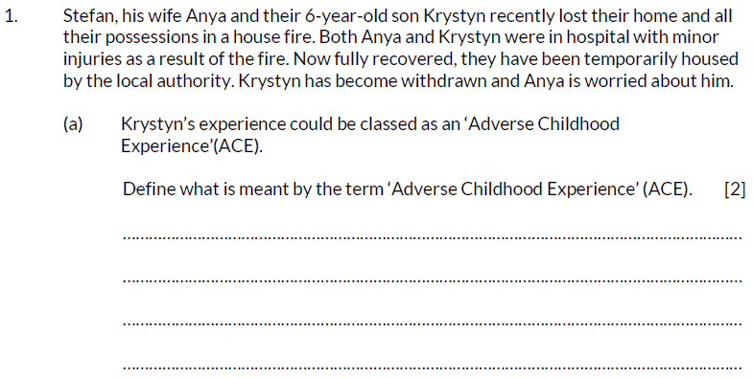
Question 1 (a), AO1
The information given at the start of some questions in the paper is called the rider. This sets the scene and gives you key information that will help you to formulate your answer.
The command word here is ‘Define’ – give the exact meaning.
Notes:
Read out the question.
The information given at the start of some questions in the paper is called the rider. This sets the scene and gives you key information that will help you to formulate your answer.
The command word here is ‘Define’ – Give the exact meaning.

Slide 8
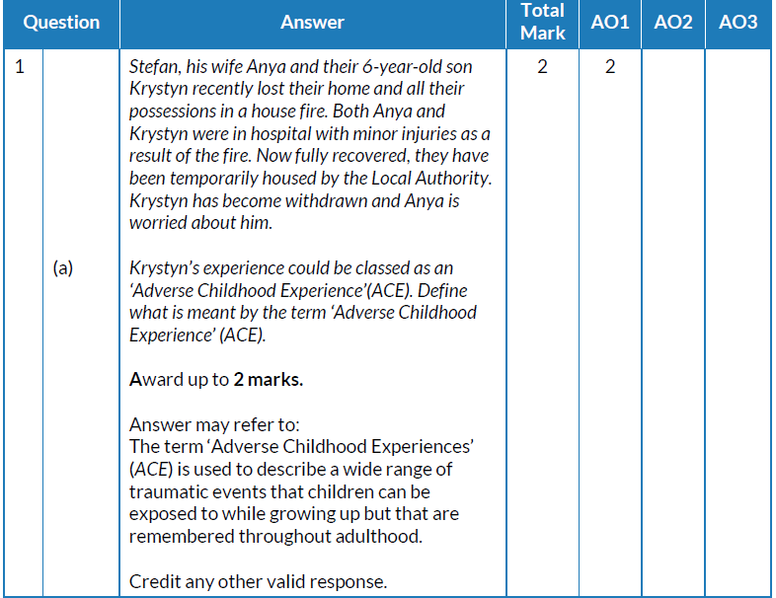
Question 1 (a) AO1 mark scheme
What we are looking for here is evidence that you can demonstrate your knowledge of ACEs.
Award yourself up to 2 marks.
Notes:
This is the mark scheme for question 1 (a).
What we are looking for here is evidence that you can demonstrate your knowledge of ACEs.
Award yourself up to 2 marks.

Slide 9
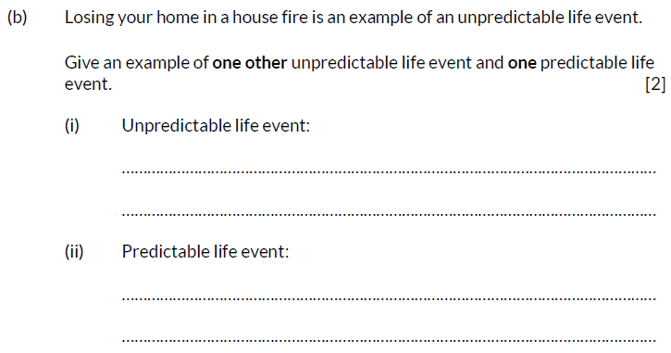
Question 1 (b), AO1
The command word here is ‘Give’ – provide, name.
Read the question carefully. Here, you are being asked for examples in your answer.
Notes:
Read out the question.
The command word here is ‘Give’ – provide, name.
Read the question carefully. Here, you are being asked for examples in your answer.

Slide 10
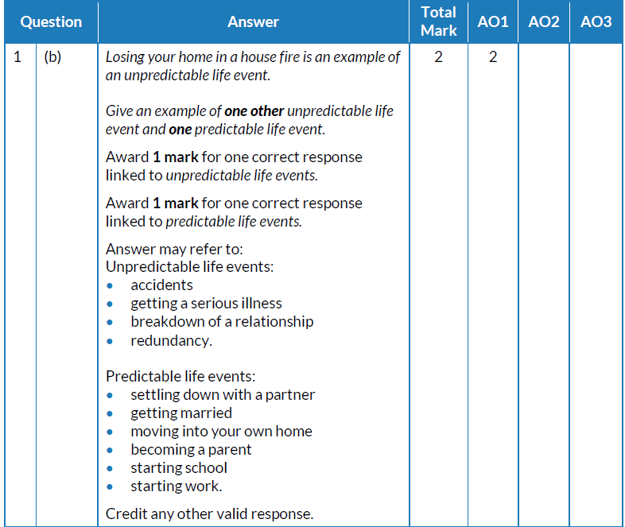
Question 1 (b) AO1 mark scheme
What we are looking for here is evidence that you can demonstrate your knowledge of predictable and unpredictable life events.
Look at your answers and underline anything in your answer that is also in these lists.
Notes:
This is the mark scheme for question 1 (b).
What we are looking for here is evidence that you can demonstrate your knowledge of predictable and unpredictable life events.
Look at your answers and underline anything in your answer that is also in these lists.

Slide 11
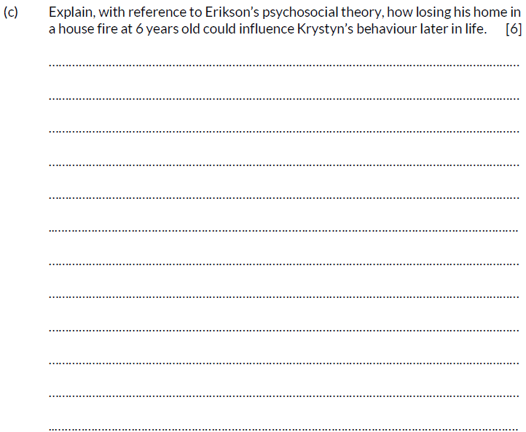
Question 1 (c), AO2
The command word here is ‘Explain’ – provide details and reasons for how and why something is the way it is.
Read the question carefully.
Here, you are being asked to make reference to Erikson’s psychosocial theory in your answer.
There are several lines for your answer which indicates that extended writing is required.
This is a high tariff question as there are 6 marks available.
Explaining both positive and negative influences will help you reach the higher mark bands.
Notes:
Read out the question.
The command word here is ‘Explain’ – provide details and reasons for how and why something is the way it is.
Read the question carefully.
Here you are being asked to make reference to Erikson’s psychosocial theory in your answer.
There are several lines for your answer which indicates that extended writing is required.
This is a high tariff question as there are 6 marks available.
Explaining both positive and negative influences will help you reach the higher mark bands.

Slide 12
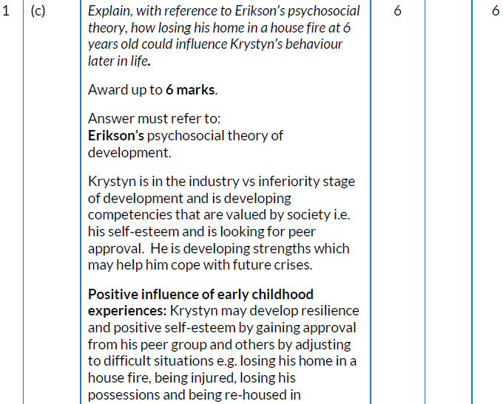
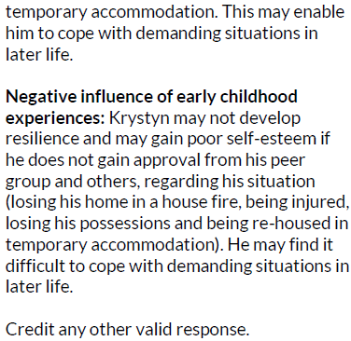
Question 1 (c) AO2 mark scheme
What we are looking for here is evidence that you can demonstrate your knowledge of Erikson’s psychosocial theory of development.
Notes:
This is the mark scheme for question 1 (c).
What we are looking for here is evidence that you can demonstrate your knowledge of Erikson’s psychosocial theory of development.

Slide 13
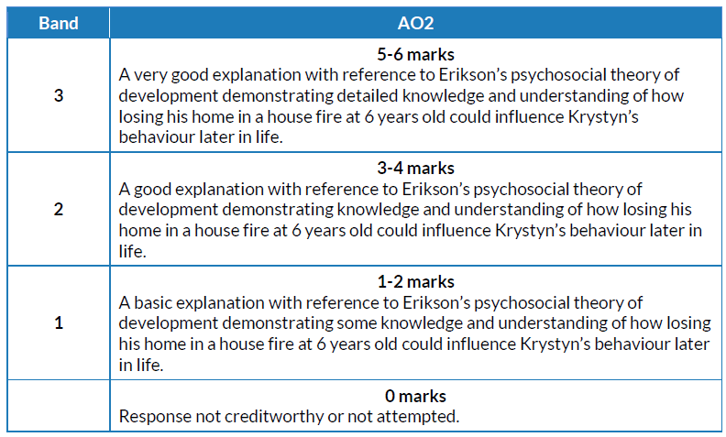
Question 1 (c) AO2 mark bands
This is a banded mark scheme – so you need to make a judgement on your response before awarding a mark.
Notes:
This is a banded mark scheme – so you need to make a judgement on your response before awarding a mark.

Slide 14
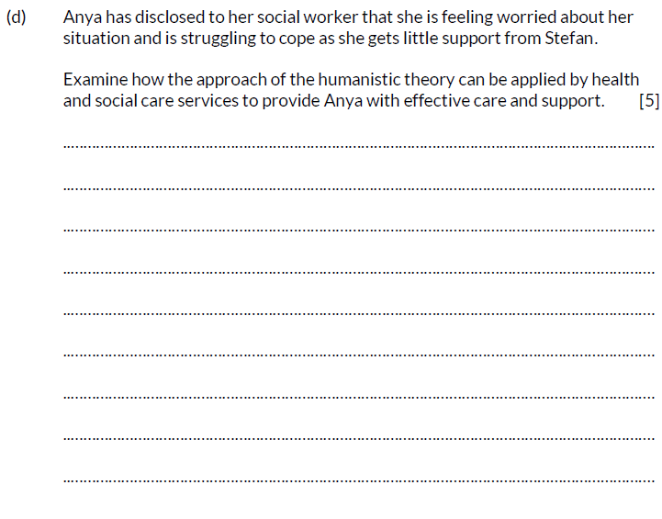
Question 1 (d), AO3
The command word here is ‘Examine’ – investigate closely, in detail.
Notes:
Read out the question.
The command word here is ‘Examine’ – investigate closely, in detail.

Slide 15
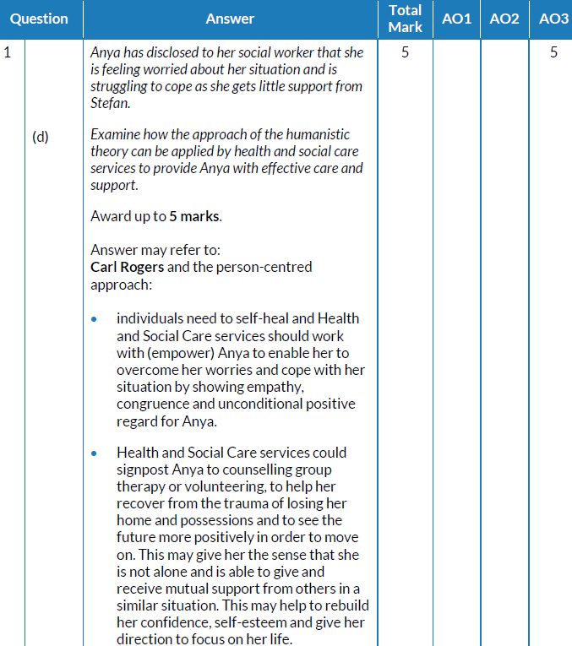
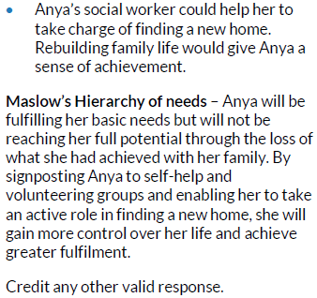
Question 1 (d) AO3 mark scheme
What we are looking for here is evidence that you can demonstrate your knowledge of Carl Rogers and the person-centred approach.
Notes:
This is the mark scheme for question 1 (d).
What we are looking for here is evidence that you can demonstrate your knowledge of Carl Rogers and the person-centred approach.

Slide 16
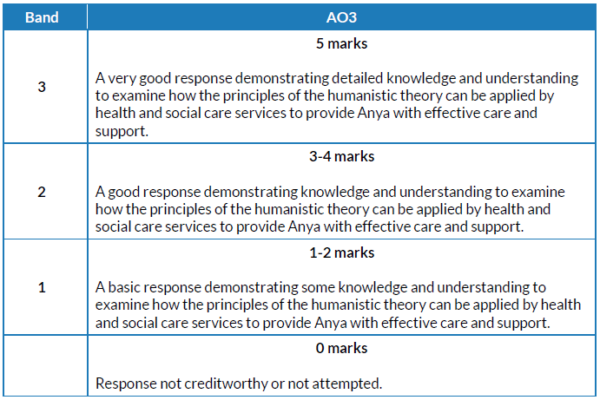
Question 1 (d) AO3 mark bands
This is a banded mark scheme – so you need to make a judgement on your response before awarding a mark.
Notes:
This is a banded mark scheme – so you need to make a judgement on your response before awarding a mark.

Slide 17
How do I tackle Question 2?
Question 2
Skills being tested:
AO1 – demonstrate knowledge and understanding of a range of key concepts, values and issues that are relevant to health and social care
AO2 – apply knowledge and understanding of health and social care principles and contexts
AO3 – analyse and evaluate health and social care theories and practice to demonstrate understanding, reflect on how they can influence practice, making reasoned judgements and drawing conclusions
Approach:
Read question 2 (a), (b), (c) and (d).
Highlight key words/command verbs.
Check the number of marks for each part of the question so you spend your time appropriately.
Think carefully about your answer.
The number of lines available indicates the length of the required response.
Notes:
Read the slide.

Slide 18
Question 2 (a), AO1
The command word here is ‘Identify’ – provide brief facts or examples.
Read the rider carefully and make sure that you relate your answer to Hasheed.
Notes:
Read out the question.
The command word here is ‘Identify’ – provide brief facts or examples.
Read the rider carefully and make sure that you relate your answer to Hasheed.

Slide 19
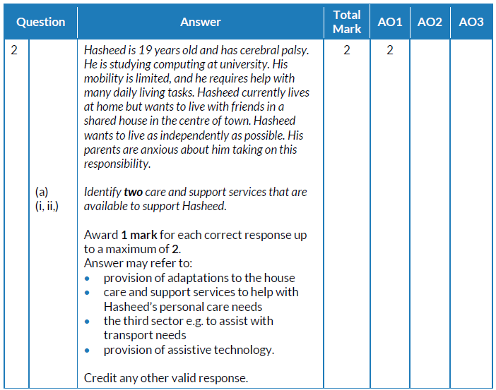
Question 2 (a) AO1 mark scheme
What we are looking for here is evidence that you can demonstrate your knowledge of care and support services.
Look at your answers and award 1 mark for each correct answer, up to a maximum of 2.
Notes:
This is the mark scheme for question 2 (a).
What we are looking for here is evidence that you can demonstrate your knowledge of care and support services.
Look at your answers and award 1 mark for each correct answer, up to a maximum of 2.

Slide 20
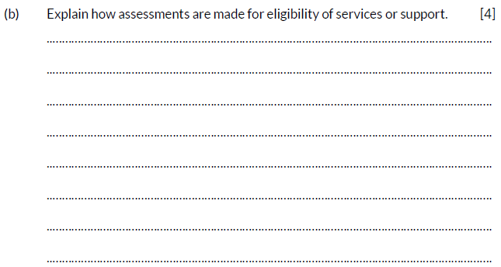
Question 2 (b), AO2
The command word here is ‘Explain’ – provide details and reasons for how and why something is the way it is.
Notes:
Read out the question.
The command word here is ‘Explain’ – provide details and reasons for how and why something is the way it is.

Slide 21
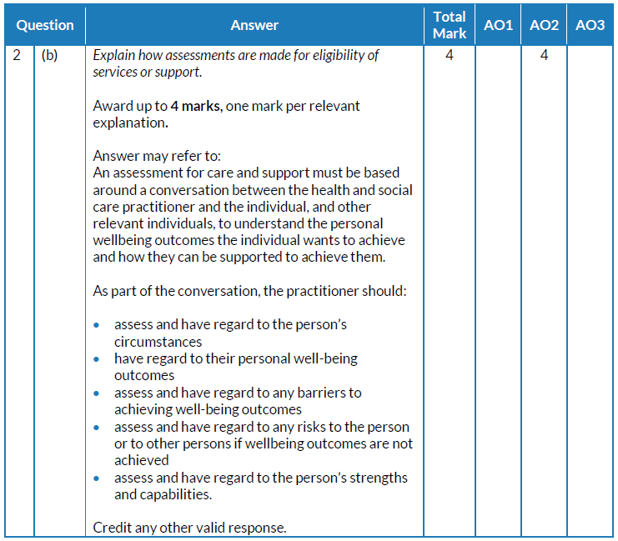
Question 2 (b) AO2 mark scheme
What we are looking for here is evidence that you can demonstrate your knowledge of assessments, services and support.
Look at your answers and underline anything that is in these lists.
Notes:
This is the mark scheme for question 2 (b).
What we are looking for here is evidence that you can demonstrate your knowledge of assessments, services and support.
Look at your answers and underline anything that is in these lists.

Slide 22
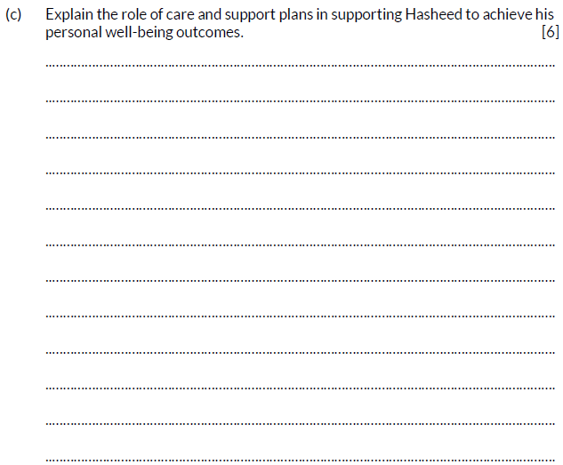
Question 2 (c), AO2
This is a 6 mark question. Plan your answer carefully. A very good and detailed answer is required in order to reach the top mark bands.
The command word here is ‘Explain’ – provide details and reasons for how and why something is the way it is.
Your answer needs to provide details of how and why care and support plans support Hasheed to achieve his well-being outcomes.
Notes:
Read out the question.
This is a 6 mark question. Plan your answer carefully. A very good and detailed answer is required in order to reach the top mark bands.
The command word here is ‘Explain’ – provide details and reasons for how and why something is the way it is.
Your answer needs to provide details of how and why care and support plans support Hasheed to achieve his well-being outcomes.

Slide 23
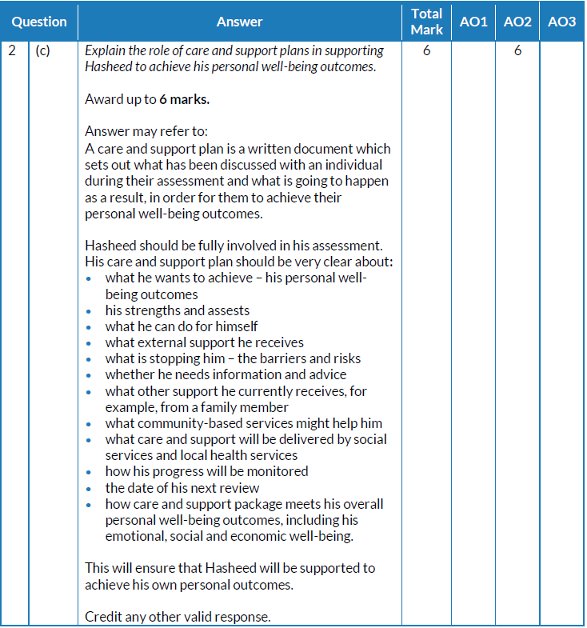
Question 2 (c) AO2 mark scheme
What we are looking for here is evidence that you can demonstrate your knowledge of the role of care and support plans.
Look at your answers and underline anything that is in the list.
Notes:
This is the mark scheme for question 2 (c).
What we are looking for here is evidence that you can demonstrate your knowledge of the role of care and support plans.
Look at your answers and underline anything that is in the list.

Slide 24
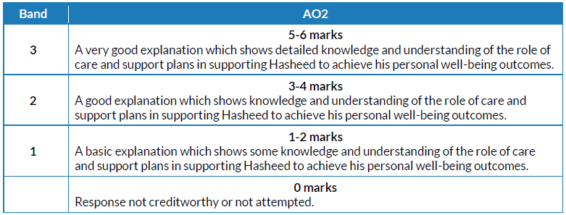
Question 2 (c) AO2 mark bands
This is a banded mark scheme – so you need to make a judgement on your response before awarding a mark.
Notes:
This is a banded mark scheme – so you need to make a judgement on your response before awarding a mark.

Slide 25
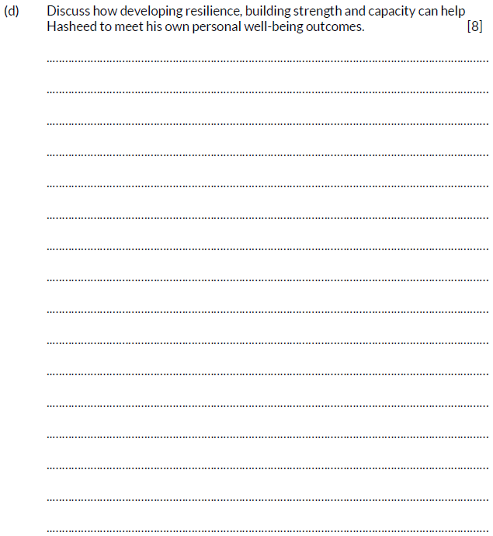
Question 2 (d), AO1 and AO3
The command word here is ‘Discuss’ – examine an issue in detail in a structured way, taking into account different ideas.
There are several key words here. You will need to address each one with reference to how they can help Rasheed meet his own well-being outcomes.
Plan your answer, and include positive and negative aspects in your discussion.
Notes:
Read out the question.
The command word here is ‘Discuss’ – examine an issue in detail in a structured way, taking into account different ideas.
There are several key words here. You will need to address each one with reference to how they can help Rasheed meet his own well-being outcomes.
Plan your answer, and include positive and negative aspects in your discussion.

Slide 26
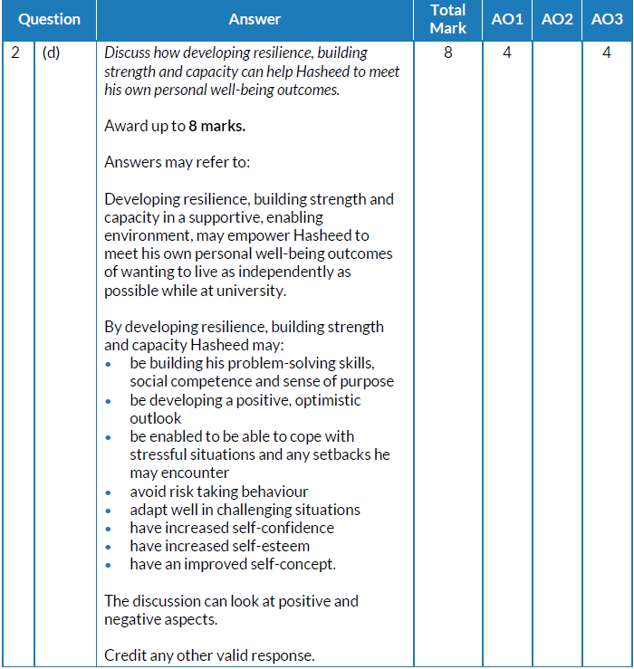
Question 2 (d) AO1 and AO3 mark scheme
What we are looking for here is evidence that you can demonstrate your knowledge of meeting well-being outcomes.
Look at your answers and underline anything that is in this list.
Notes:
This is the mark scheme for question 2 (d).
What we are looking for here is evidence that you can demonstrate your knowledge of meeting well-being outcomes.
Look at your answers and underline anything that is in this list.

Slide 27
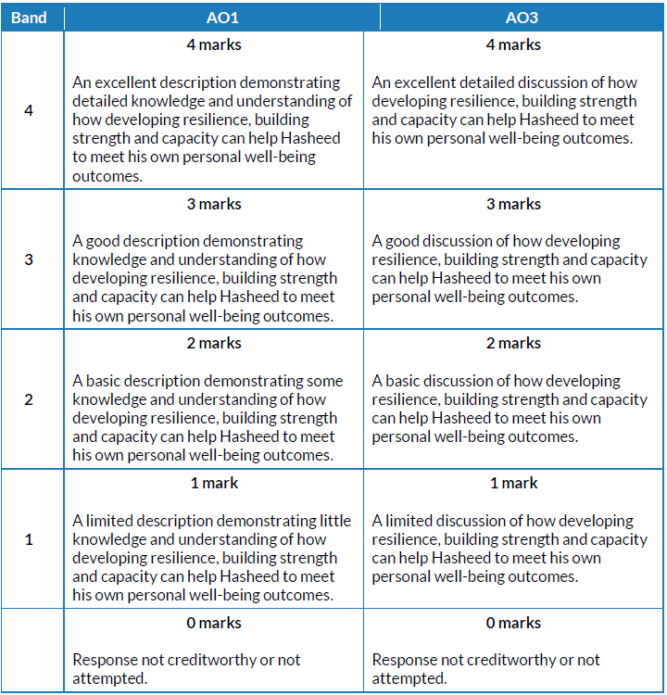
Question 2 (d) AO1and AO3 mark bands
This is a banded mark scheme; marks here are also split between AO1 and AO3 – so you need to make a judgement on your response before awarding a mark.
Notes:
This is a banded mark scheme; marks here are also split between AO1 and AO3 – so you need to make a judgement on your response before awarding a mark.

Slide 28
How do I tackle Question 3?
Question 3
Skills being tested:
AO1 – demonstrate knowledge and understanding of a range of key concepts, values and issues that are relevant to health and social care
AO2 – apply knowledge and understanding of health and social care principles and contexts
AO3 – analyse and evaluate health and social care theories and practice to demonstrate understanding, reflect on how they can influence practice, making reasoned judgements and drawing conclusions
Approach:
Read question 3 (a), (b) and (c).
Highlight key words/command verbs.
Check the number of marks for each part of the question so you spend your time appropriately.
Think carefully about your answer.
The number of lines available indicates the length of the required response.
Notes:
Read the slide.

Slide 29
Question 3 (a), AO1
The command word here is ‘Identify’ – provide brief facts or examples.
Notes:
Read out the question.
The command word here is ‘Identify’ – provide brief facts or examples.

Slide 30
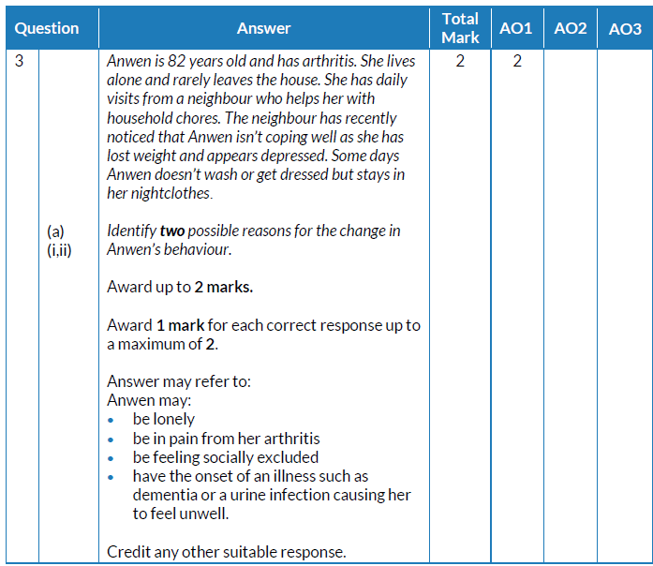
Question 3 (a) AO1 mark scheme
What we are looking for here is evidence that you can demonstrate your knowledge of factors that affect human growth and development across the lifespan.
Notes:
This is the mark scheme for question 3 (a).
What we are looking for here is evidence that you can demonstrate your knowledge of factors that affect human growth and development across the lifespan.

Slide 31
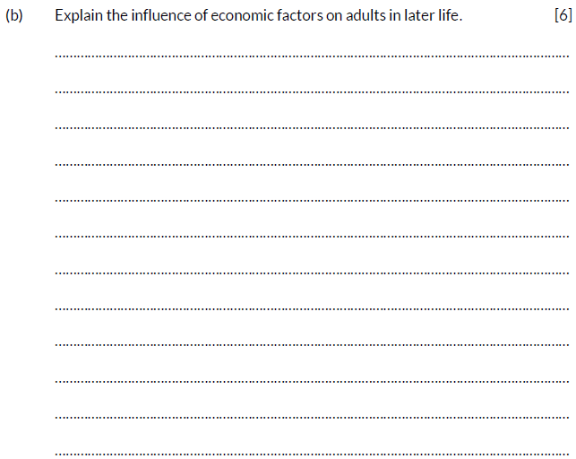
Question 3 (b), AO2
The command word here is ‘Explain’ – provide details and reasons for how and why something is the way it is.
Think carefully about your answer. Key words to underline are ‘influence’, ‘economic factors’, ‘adults’ and ‘later life’.
Notes:
Read out the question.
The command word here is ‘Explain’ – provide details and reasons for how and why something is the way it is.
Think carefully about your answer. Key words to underline are ‘influence’, ‘economic factors’, ‘adults’ and ‘later life’.

Slide 32
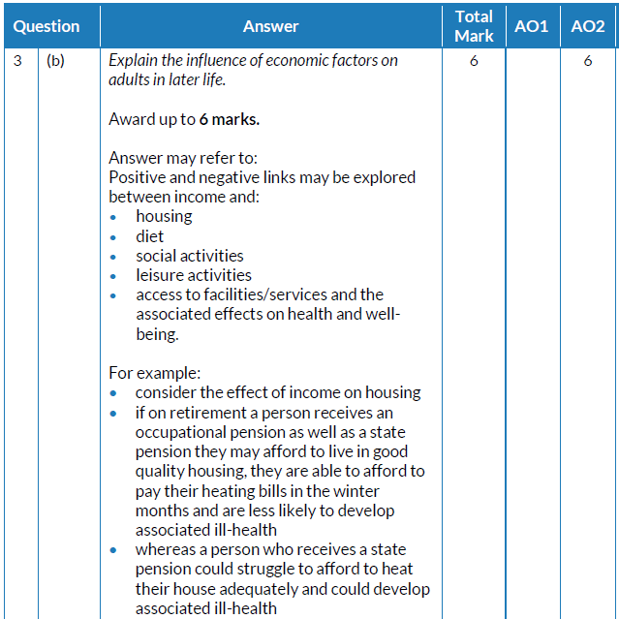
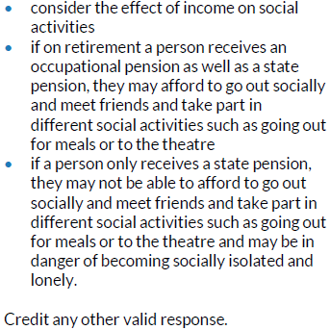
Question 3 (b) AO2 mark scheme
What we are looking for here is evidence that you can demonstrate your knowledge of the influence of economic factors on adults in later life.
Look at your answers and underline anything that is in these lists.
Notes:
This is the mark scheme for question 3 (b).
What we are looking for here is evidence that you can demonstrate your knowledge of the influence of economic factors on adults in later life.
Look at your answers and underline anything that is in these lists.

Slide 33
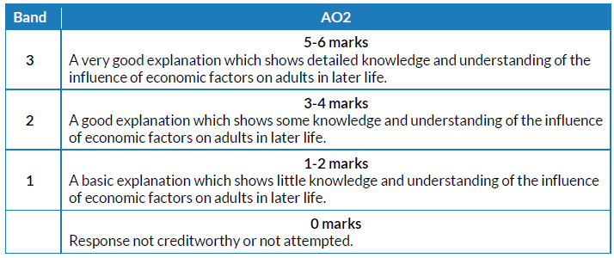
Question 3 (b) AO2 mark bands
This is a banded mark scheme – so you need to make a judgement on your response before awarding a mark.
Notes:
This is a banded mark scheme – so you need to make a judgement on your response before awarding a mark.

Slide 34
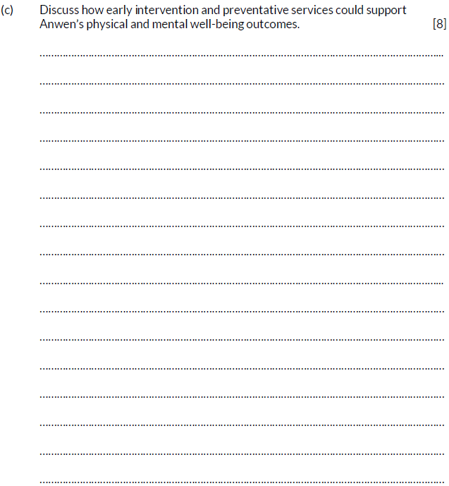
Question 3 (c), AO1 and AO3
The command word here is ‘Discuss’ – examine an issue in detail in a structured way, taking into account different ideas.
There are several key words here. You will need to address each one with reference to supporting Anwen’s physical and mental well-being outcomes.
To achieve the higher mark bands, your answer needs to discuss different ideas and not just describe them.
Notes:
Read out the question.
The command word here is ‘Discuss’ – examine an issue in detail in a structured way, taking into account different ideas.
There are several key words here. You will need to address each one with reference to supporting Anwen’s physical and mental well-being outcomes.
To achieve the higher mark bands, your answer needs to discuss different ideas and not just describe them.

Slide 35
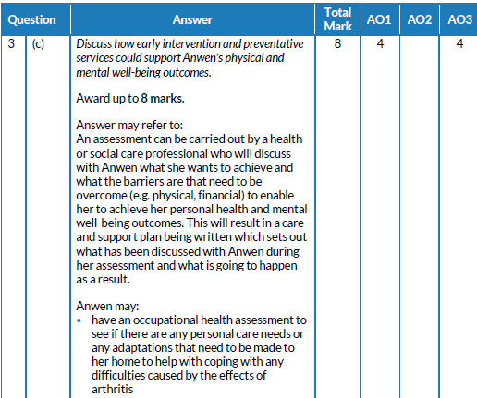
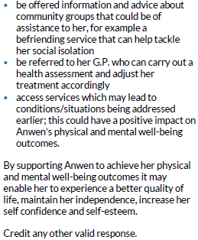
Question 3 (c) AO1 and AO3 mark scheme
What we are looking for here is evidence that you can demonstrate your knowledge of intervention and preventative services and how they could support Anwen’s physical and mental well-being outcomes.
Notes:
This is the mark scheme for question 3 (c).
What we are looking for here is evidence that you can demonstrate your knowledge of intervention and preventative services and how they could support Anwen’s physical and mental well-being outcomes.

Slide 36
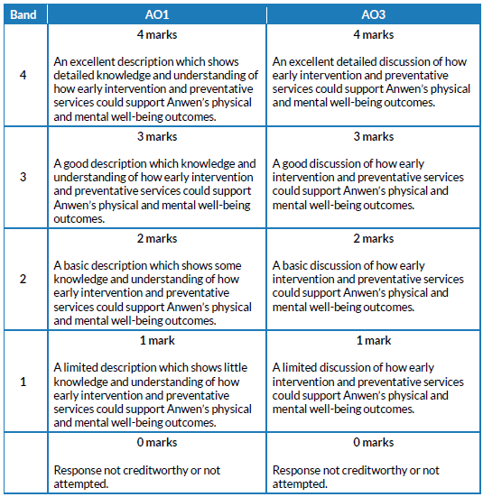
Question 3 (c) AO1 and AO3 mark bands
This is a banded mark scheme; marks here are also split between AO1 and AO3 – so you need to make a judgement on your response before awarding a mark.
Notes:
This is a banded mark scheme; marks here are also split between AO1 and AO3 – so you need to make a judgement on your response before awarding a mark.

Slide 37
How do I tackle Question 4?
Question 4
Skills being tested:
AO2 – apply knowledge and understanding of health and social care principles and contexts
AO3 – analyse and evaluate health and social care theories and practice to demonstrate understanding, reflect on how they can influence practice, making reasoned judgements and drawing conclusions
Approach:
Read question 4 (a) and (b).
Highlight key words/command verbs.
Check the number of marks for each part of the question so you spend your time appropriately.
Think carefully about your answer.
The number of lines available indicates the length of the required response.
Notes:
Read the slide.

Slide 38
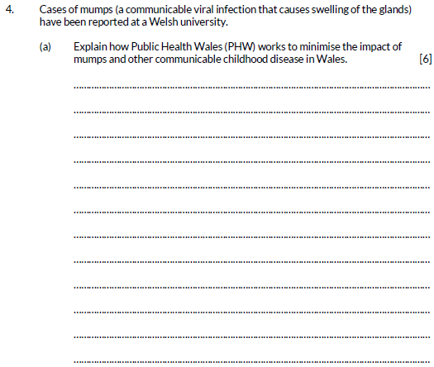
Question 4 (a), AO2
The command word here is ‘Explain’ – provide details and reasons for how and why something is the way it is.
Think carefully about your answer. Key words to underline are ‘minimise the impact’, ‘mumps and other communicable childhood disease’ and ‘Wales’
Notes:
Read out the question.
The command word here is ‘Explain’ – provide details and reasons for how and why something is the way it is.
Think carefully about your answer. Key words to underline are ‘minimise the impact’, ‘mumps and other communicable childhood disease’ and ‘Wales’.

Slide 39
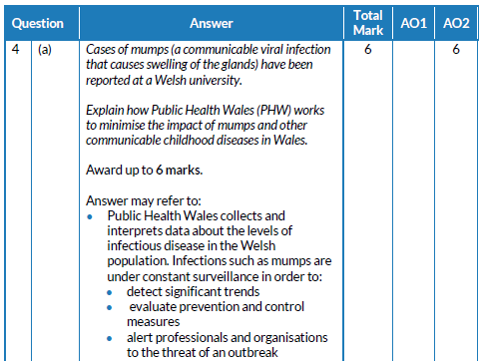
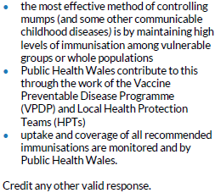
Question 4 (a) AO2 mark scheme
What we are looking for here is evidence that you can demonstrate your knowledge of health and social care provision in Wales.
Look at your answers and underline anything that is in this list.
Notes:
This is the mark scheme for question 4 (a).
What we are looking for here is evidence that you can demonstrate your knowledge of health and social care provision in Wales.
Look at your answers and underline anything that is in this list.

Slide 40
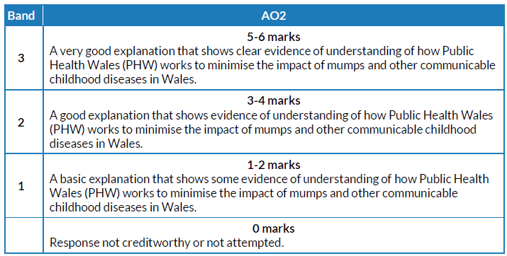
Question 4 (a) AO2 mark bands
This is a banded mark scheme – so you need to make a judgement on your response before awarding a mark.
Notes:
This is a banded mark scheme – so you need to make a judgement on your response before awarding a mark.

Slide 41
Question 4 (b), AO3
The command word here is ‘Examine’ – investigate closely and in detail.
This is a high tariff question. Plan your answer carefully.
Key words – ‘role’, monitoring’, ‘health’, ‘nation’ (Wales).
Notes:
Read out the question.
The command word here is ‘Examine’ – investigate closely and in detail.
This is a high tariff question. Plan your answer carefully.
Key words – ‘role’, monitoring’, ‘health’, ‘nation’ (Wales).

Slide 42
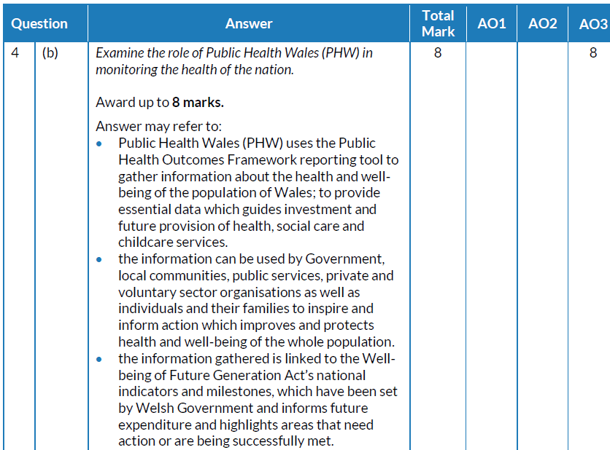
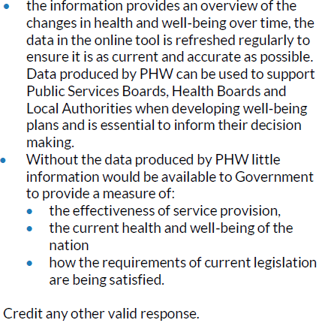
Question 4 (b) AO3 mark scheme
What we are looking for here is evidence that you can demonstrate your knowledge of the role of Public Health Wales.
Look at your answers and underline anything that is in this list.
Notes:
This is the mark scheme for question 4 (b).
What we are looking for here is evidence that you can demonstrate your knowledge of the role of Public Health Wales.
Look at your answers and underline anything that is in this list.

Slide 43
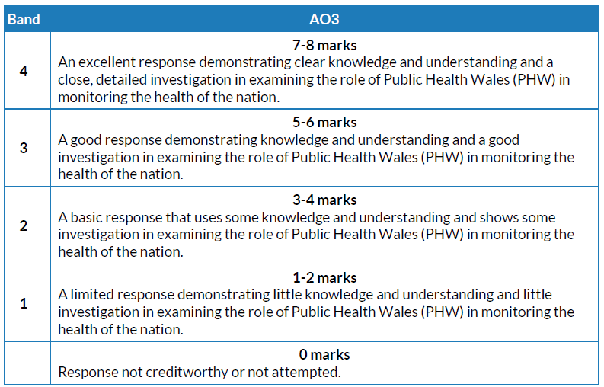
Question 4 (b) AO3 mark bands
This is a banded mark scheme – so you need to make a judgement on your response before awarding a mark.
Notes:
This is a banded mark scheme – so you need to make a judgement on your response before awarding a mark.

Slide 44
How do I tackle Question 5?
Question 5
Skills being tested:
AO1 – demonstrate knowledge and understanding of a range of key concepts, values and issues that are relevant to health and social care
AO3 – analyse and evaluate health and social care theories and practice to demonstrate understanding, reflect on how they can influence practice, making reasoned judgements and drawing conclusions
Approach:
Read question 5 (a) and (b).
Highlight key words/command verbs.
Check the number of marks for each part of the question so you spend your time appropriately.
Think carefully about your answer.
The number of lines available indicates the length of the required response.
Notes:
Read the slide.

Slide 45
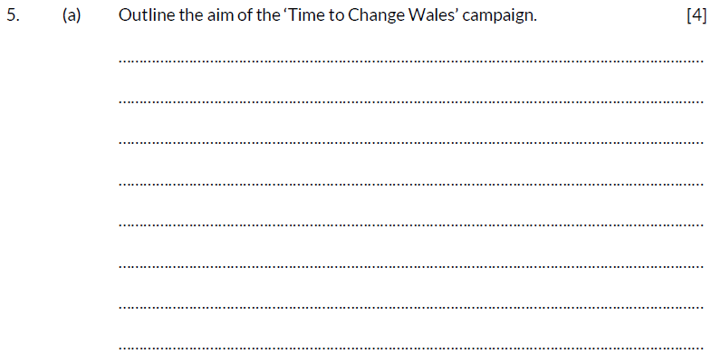
Question 5 (a), AO1
The command word here is ‘Outline’ – set out the main points/ provide a brief description or main characteristics.
The number of lines and marks available indicate how much to write in your response.
Notes:
Read out the question.
The command word here is ‘Outline’ – set out the main points/provide a brief description or main characteristics.
The number of lines and marks available indicate how much to write in your response.

Slide 46
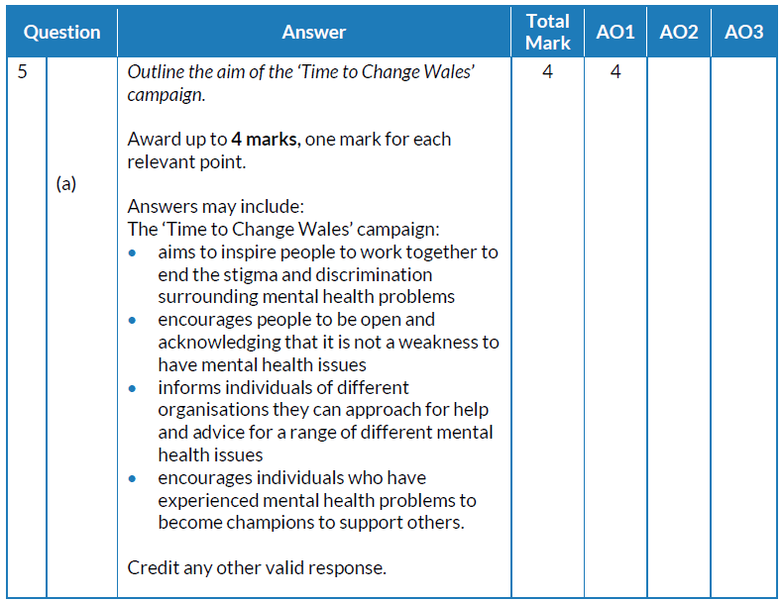
Question 5 (a) AO1 mark scheme
What we are looking for here is evidence that you can demonstrate your knowledge of health and support provision in Wales.
Look at your answers and underline anything that is in this list.
Notes:
This is the mark scheme for question 5 (a).
What we are looking for here is evidence that you can demonstrate your knowledge of health and support provision in Wales.
Look at your answers and underline anything that is in this list.

Slide 47
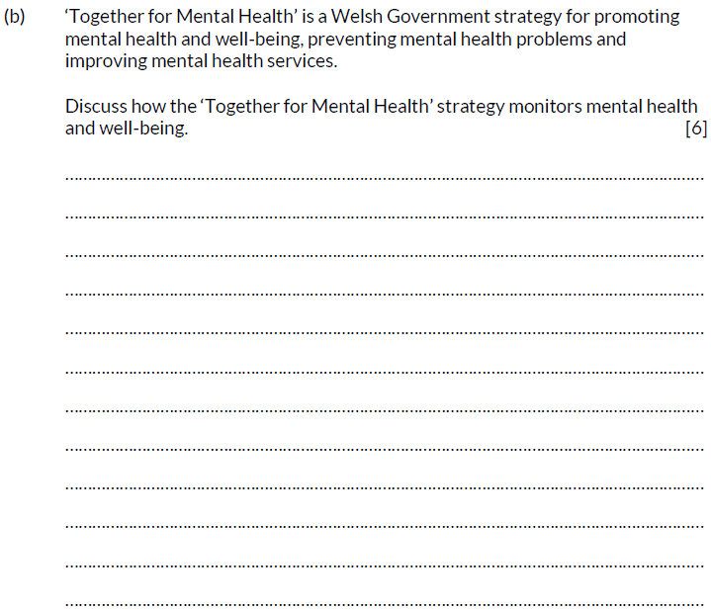
Question 5 (b), AO3
The command word here is Discuss’ – examine an issue in detail in a structured way, taking into account different ideas.
To achieve the higher mark bands, your answer needs to discuss different ideas, and not just describe them.
Notes:
Read out the question.
The command word here is Discuss’ – Examine an issue in detail in a structured way, taking into account different ideas.
To achieve the higher mark bands, your answer needs to discuss different ideas, and not just describe them.

Slide 48
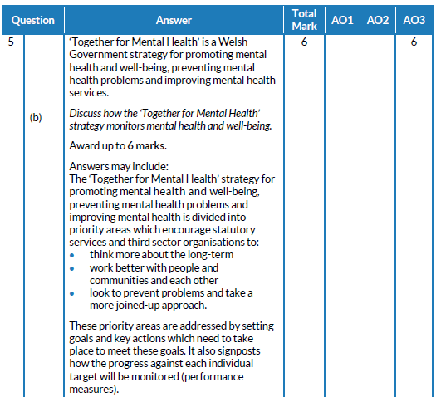
Question 5 (b) AO3 mark scheme
What we are looking for here is evidence that you can demonstrate your knowledge of how individuals and the nation monitor health and well-being.
Notes:
This is the mark scheme for question 5 (b).
What we are looking for here is evidence that you can demonstrate your knowledge of how individuals and the nation monitor health and well-being.

Slide 49
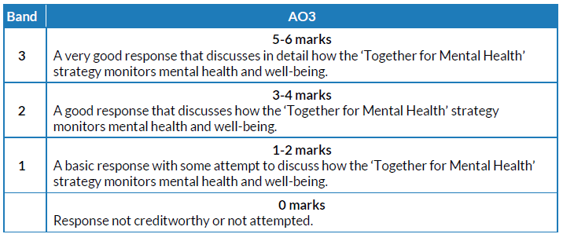
Question 5 (b) AO3 mark bands
This is a banded mark scheme – so you need to make a judgement on your response before awarding a mark.
Notes:
This is a banded mark scheme – so you need to make a judgement on your response before awarding a mark.

Slide 50
How do I tackle Question 6?
Question 6
Skills being tested:
AO1 – demonstrate knowledge and understanding of a range of key concepts, values and issues that are relevant to health and social care
AO3 – analyse and evaluate health and social care theories and practice to demonstrate understanding, reflect on how they can influence practice, making reasoned judgements and drawing conclusions
Approach:
Read question 6 (a) and (b).
Highlight key words/command verbs.
Check the number of marks for each part of the question so you spend your time appropriately.
Think carefully about your answer.
The number of lines available indicates the length of the required response.
Notes:
Read the slide.

Slide 51
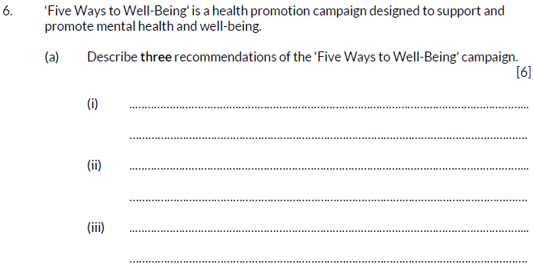
Question 6 (a), AO1
The command word here is ‘ Describe’ – provide characteristics/main features or a brief account.
Each recommendation needs to be different – take care not to repeat yourself.
Notes:
Read out the question.
The command word here is ‘ Describe’ – provide characteristics/main features or a brief account.
Each recommendation needs to be different – take care not to repeat yourself.

Slide 52
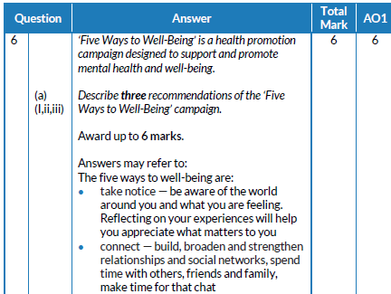
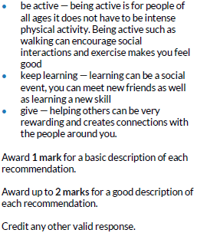
Question 6 (a) AO1 mark scheme
What we are looking for here is evidence that you can demonstrate your knowledge of approaches to promoting and protecting health and well-being.
Look at your answers and underline anything that is in this list.
Notes:
What we are looking for here is evidence that you can demonstrate your knowledge of approaches to promoting and protecting health and well-being.
Look at your answers and underline anything that is in this list.

Slide 53
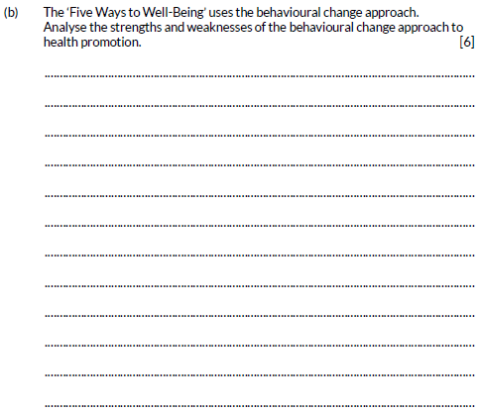
Question 6 (b), AO1 and AO3
The command word here is ‘Analyse’ – examine an issue in detail/how parts relate to whole, to explain and interpret.
Strengths – positives
Weaknesses – negatives
Notes:
Read out the question.
The command word here is ‘Analyse’ – examine an issue in detail/how parts relate to whole, to explain and interpret.
Strengths – positives
Weaknesses – negative

Slide 54
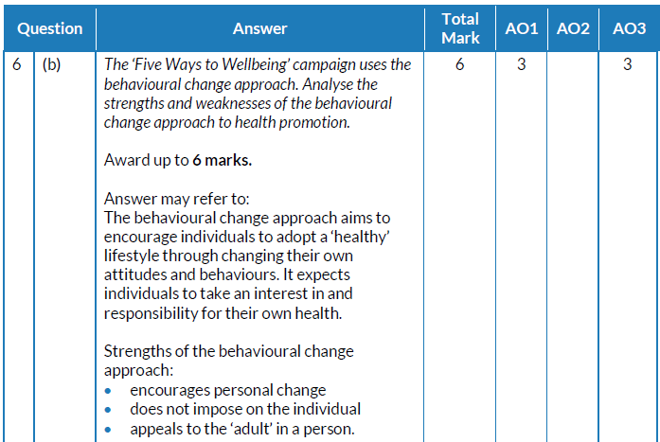
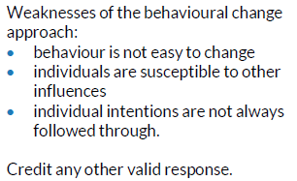
Question 6 (b) AO1 and AO3 mark scheme
What we are looking for here is evidence that you can demonstrate your knowledge of the behavioral change approach to health and well-being.
Look at your answers and underline anything that is in this list.
Notes:
This is the mark scheme for question 6 (b).
What we are looking for here is evidence that you can demonstrate your knowledge of the behavioral change approach to health and well-being.
Look at your answers and underline anything that is in this list.

Slide 55
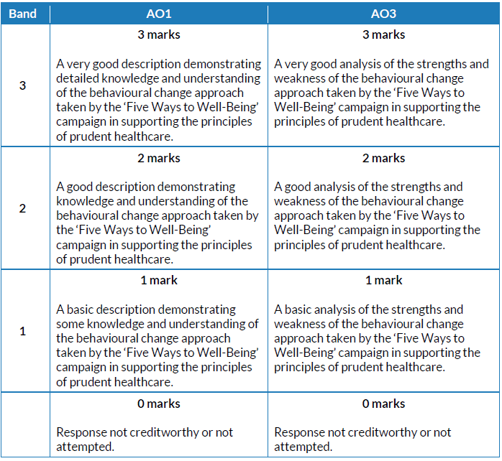
Question 6 (b) AO1 and AO3 mark bands
This is a banded mark scheme; marks here are also split between AO1 and AO3 – so you need to make a judgement on your response before awarding a mark.
Notes:
This is a banded mark scheme; marks here are also split between AO1 and AO3 – so you need to make a judgement on your response before awarding a mark.

Slide 56
How do I tackle Question 7?
Question 7
Skills being tested:
AO1 – demonstrate knowledge and understanding of a range of key concepts, values and issues that are relevant to health and social care
AO2 – apply knowledge and understanding of health and social care principles and contexts
AO3 – analyse and evaluate health and social care theories and practice to demonstrate understanding, reflect on how they can influence practice, making reasoned judgements and drawing conclusions
Approach:
Read question 7 (a) and (b).
Highlight key words/command verbs.
Check the number of marks for each part of the question so you spend your time appropriately.
Think carefully about your answer.
The number of lines available indicates the length of the required response.
Notes:
Read the slide.

Slide 57
Question 7 (a), AO2
The command word here is ‘Explain’ – provide details and reasons for how and why something is the way it is.
5 marks are available here. Do not just describe multi-agency working; provide details and reasons.
Notes:
Read out the question.
The command word here is ‘Explain’ – provide details and reasons for how and why something is the way it is.
5 marks are available here. Do not just describe multi-agency working; provide details and reasons.

Slide 58
Question 7 (a) AO2 mark scheme
What we are looking for here is evidence that you can demonstrate your knowledge of approaches to promoting and protecting resilience.
Notes:
This is the mark scheme for question 7 (a).
What we are looking for here is evidence that you can demonstrate your knowledge of approaches to promoting and protecting resilience.

Slide 59
Question 7 (b), AO1 and AO3
The command word here is ‘Discuss’ – examine an issue in detail in a structured way, taking into account different ideas.
In order to reach the higher mark bands, it is important that, in your answer, you discuss the role and effectiveness of the approaches and don’t simply describe them.
Your answer should relate to promoting and protecting the resilience of individuals.
Notes:
Read out the question.
The command word here is ‘Discuss’ – examine an issue in detail in a structured way, taking into account different ideas.
In order to reach the higher mark bands, it is important that, in your answer, you discuss the role and effectiveness of the approaches and don’t simply describe them.
Your answer should relate to promoting and protecting the resilience of individuals.

Slide 60
Question 7 (b) AO1 and AO3 mark scheme
What we are looking for here is evidence that you can demonstrate your knowledge of approaches that may be used to promote and protect the resilience of individuals.
Look at your answers and underline anything that is in this list.
Notes:
This is the mark scheme for question 7 (b).
What we are looking for here is evidence that you can demonstrate your knowledge of approaches that may be used to promote and protect the resilience of individuals.
Look at your answers and underline anything that is in this list.

Slide 61
Question 7 (b) AO1 and AO3 mark bands
This is a banded mark scheme; marks here are also split between AO1 and AO3 – so you need to make a judgement on your response before awarding a mark.
Notes:
This is a banded mark scheme; marks here are also split between AO1 and AO3 – so you need to make a judgement on your response before awarding a mark.

Slide 62
How did you do?
As the first assessment for this unit is January 2021, raw mark grade boundaries are not available.
The Uniform Mark Scale (UMS) is used as a device for reporting, recording and aggregating your unit assessment outcomes. The UMS is used so that you and others who achieve the same standard will have the same uniform mark, irrespective of when you take the unit. The maximum uniform mark for any unit depends on that unit’s weighting in the specification. This unit carries a weighting of 50% of the certificate and 25% of the diploma.
Uniform marks for this unit correspond to unit grades as follows:
Notes:
Well done – you have made it to the end of the paper.
You should now be able to give yourself a mark out of 100.
As there are no previous examinations from which to give you an indication of how you would have achieved, it is best to be guided by the UMS scale as detailed in this slide.

Slide 63
Any questions?
Do you have any further questions about this exam?
If so, write them on a Post-It note and stick it to the front of your paper to give to your teacher.

